Slide 1
CORE JAVA - MINI PROJECT
ATM Interface
By,
S.Sivaranjani

Slide 2
CONTENTS
Introduction
Main Class
Atm operation Implements
Atm operation Interface
ATM Class
Conclusion

Slide 3
Introduction
An Automated Teller Machine is a self service banking machine attached to a host computer through a telephone network.
Services available through an ATM includes,
View Available Balance
Withdraw Amount
Deposit Amount
View Mini Statement

Slide 4
Main Class
In this main class it contains the account number and the pin number ,Then it deals with multiple choice according to the user needs.
Already the pin number is set by the user and it will check with that user account . If both are true it goes on further steps accordingly.
It give the choice like View Account balance, withdraw amount, deposit amount and view mini statement.

Slide 5
ATM Class
In the ATM class we have declared the variable for balance , deposit amount and withdraw amount.
And then we have created the getter and setter method for those fields.

Slide 6
Atm Operation
Interface:
It contain all the 4 methods to evaluate like view balance, withdraw amount , deposit amount and view mini statement.
Implements:
It implements the condition of the operation to execute the statement.
It calculates the money transfer which are all happened in our account.

Slide 7
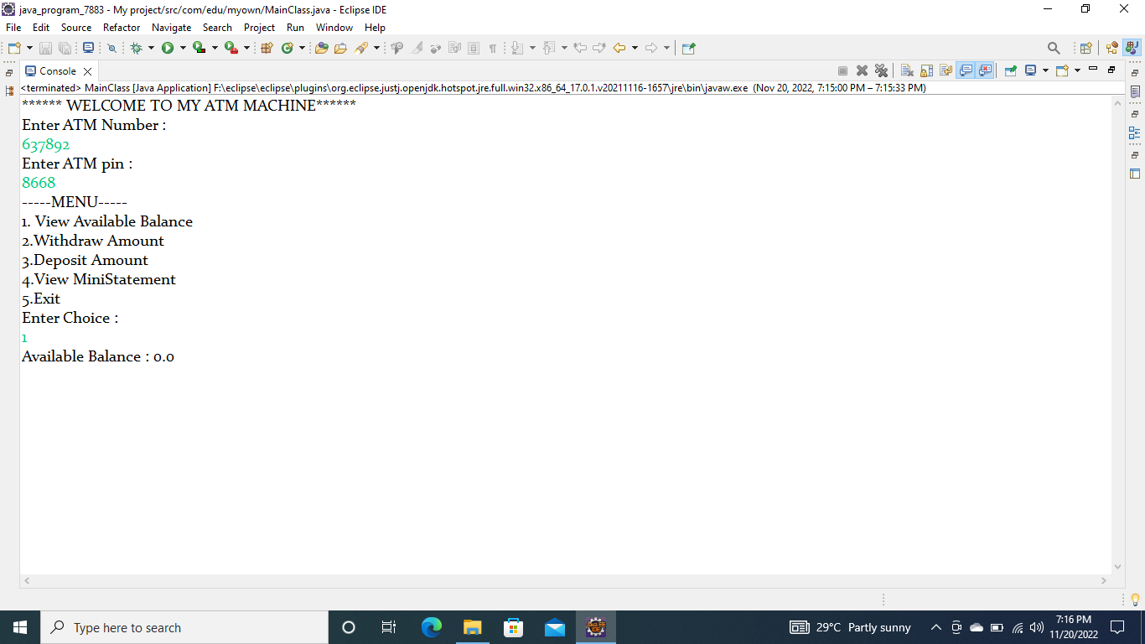

Slide 8
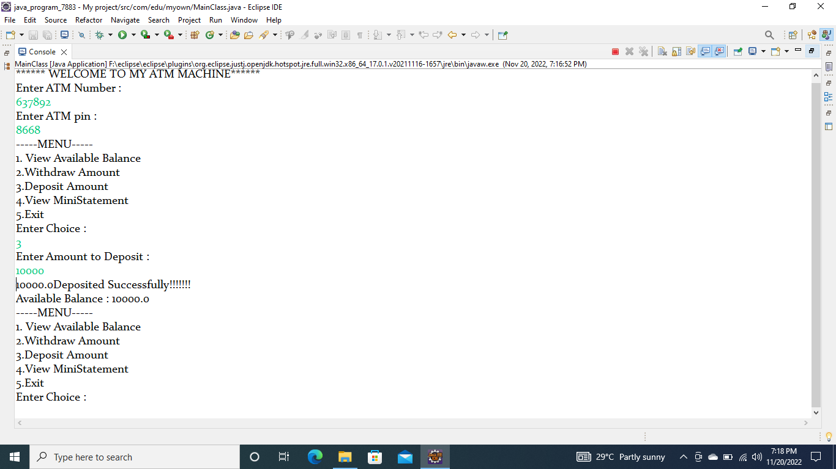

Slide 9
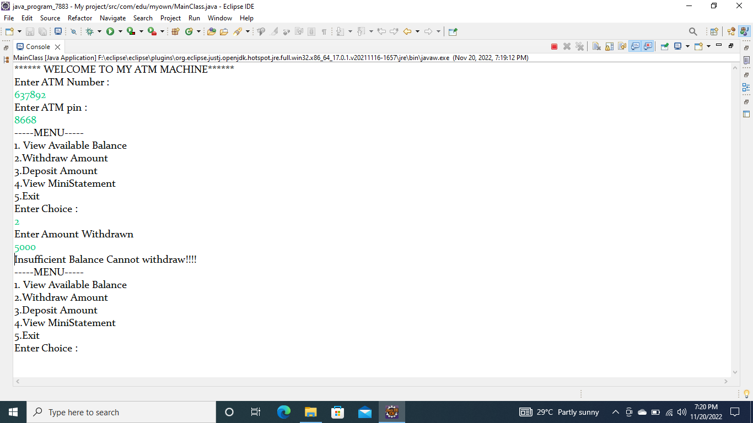

Slide 10
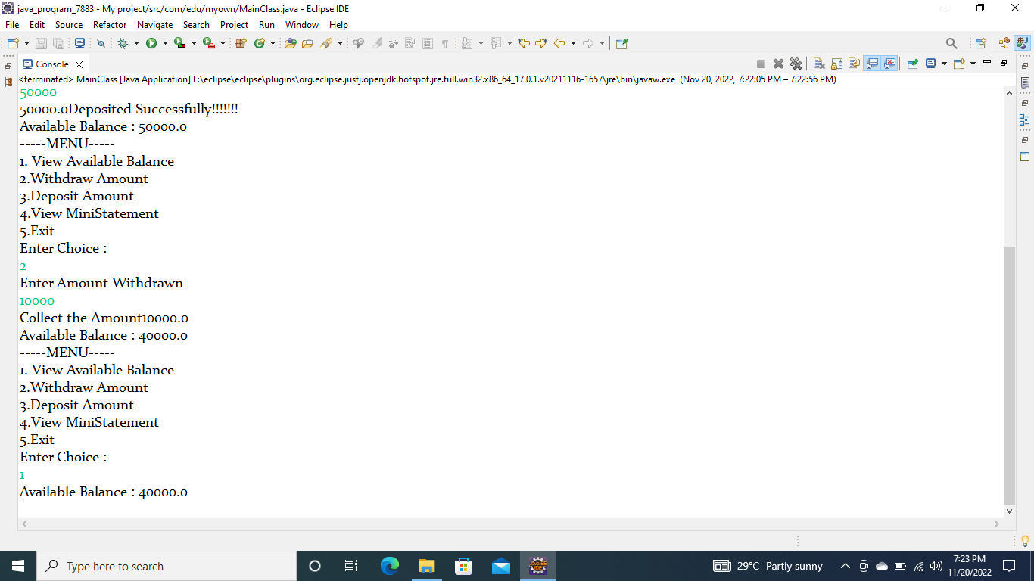

Slide 11
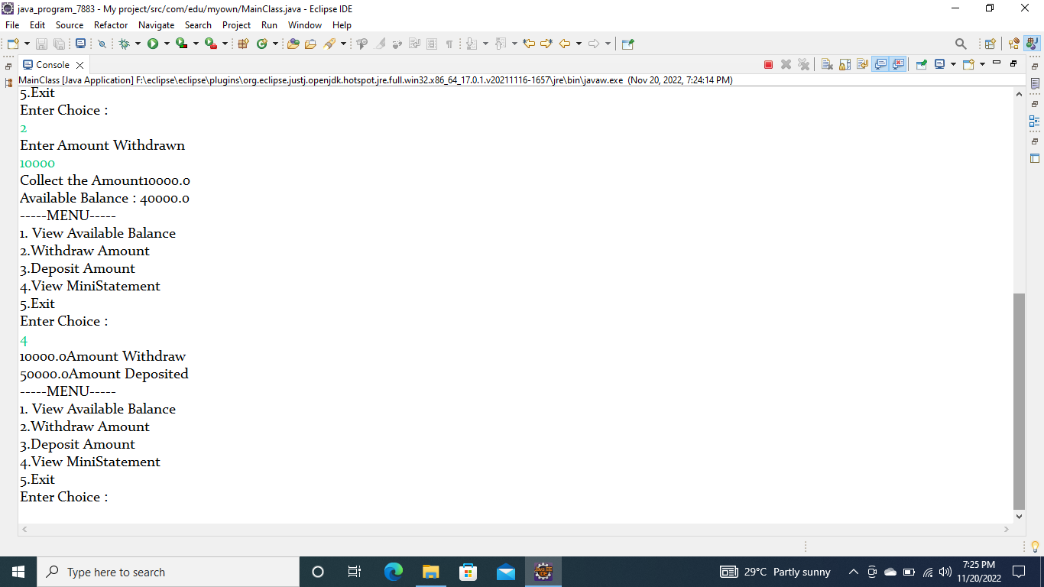

Slide 12


Slide 13
Conclusion
This project on “ ATM Interface ” has been developed as the best flexible and efficient project within the available resources and the time.
It is implemented by only using the core java part.

